Slide 1

Exploratory Data Analysis
G2M Insight for Investment in Cab Firm
August 2023
Siobhan Hwang

Slide 2
Agenda
Objective Statement
Candidate Summary
Approach
Exploratory Data Analysis (EDA)
EDA Summary
Recommendation

Slide 3
Objective Statement
Investor: XYZ
Purpose: G2M strategy for investment
Candidates: Yellow Cab, Pink Cab
Intended Result: Recommend investment in one of the candidates based on historical data exploration

Slide 4
Candidate Summary 2016-2018
 | Yellow Cab | Pink Cab
Average Yearly Profit | 14,673,460.00 | 1,769,109.33
Total Customers | 39,896 | 32,330
Total Rides | 27,4681 | 84,711
Top Cities (Total Rides) | 1. New York, NY 2. Chicago, IL | 1. Los Angeles, CA 2. New York, NY
Top Cities (% Total Customers) | Washington DC New York, NY | 1. Nashville, TN 2. Sacramento, CA

Slide 5
Approach
Available Data 359,352 Data Points
Transaction IDs
Cities of Service
Population
Total Cab Users
Customer Information
Customer ID
Gender
Age
Monthly Income
Ride Information
Date of Travel
Kilometers Travelled
Price Charged
Cost of Trip
Payment Method
Profit (=Price-Cost)
Statistically manipulate the available data to provide visual insight into the candidates’ history from 2016-2018

Slide 6
Ride Analysis
Total Rides by Company
Total Rides by Company per Year
Percent of Total Rides by Year
Total Rides by Company per Month
Percent Change in Total by Year
Total Rides by City
Percent of Total Rides by City
Exploratory Data Analysis (EDA)

Slide 7
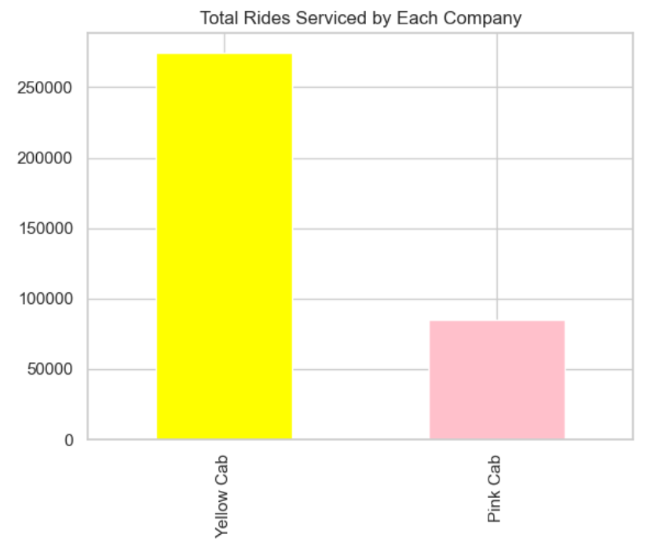
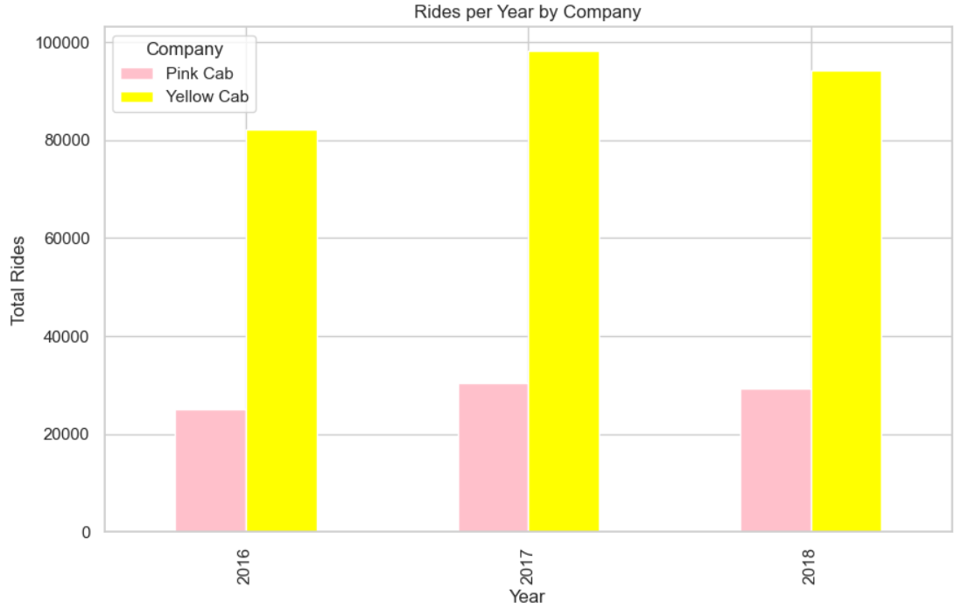
Ride Analysis Total & Year Total
98,189
94,253
274,681
82,239
84,711
30,321
29,310
25,080
Exploratory Data Analysis (EDA)

Slide 8
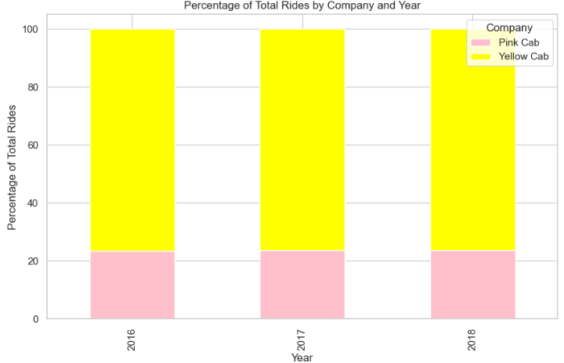
Ride Analysis Percentage by Year
76.6%
76.4%
76.2%
23.3%
23.6%
23.7%
Exploratory Data Analysis (EDA)

Slide 9
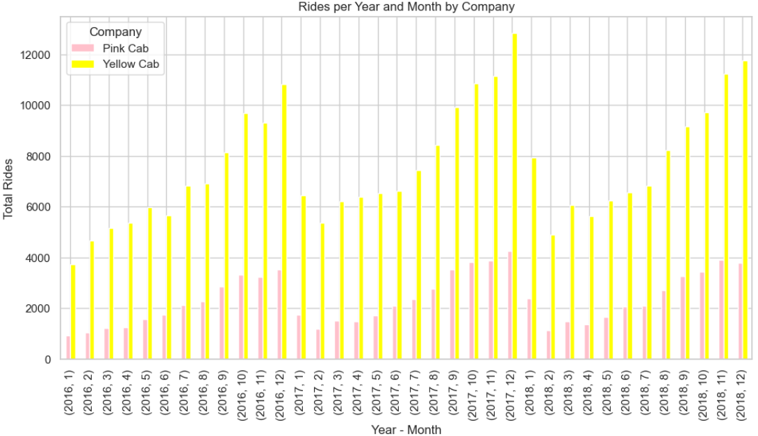
Ride Analysis Total per Month
Trends
Changes in number of rides by month follow a similar pattern irrespective of company
December consistently sees the most rides serviced for Yellow Cab over all years and for Pink Cab in 2016 and 2017.
Exploratory Data Analysis (EDA)

Slide 10
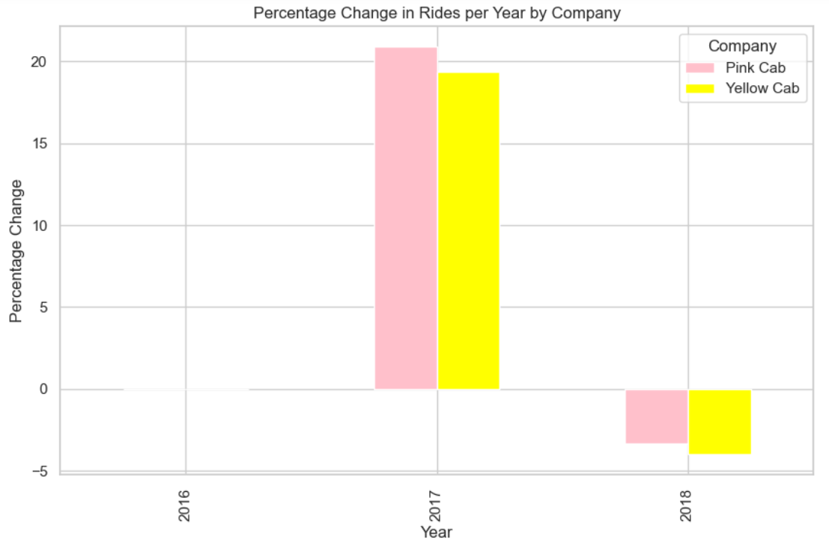
Ride Analysis Percent Change
21%
19%
No bars for 2016 because that is where the data starts.
-3%
-4%
Exploratory Data Analysis (EDA)

Slide 11
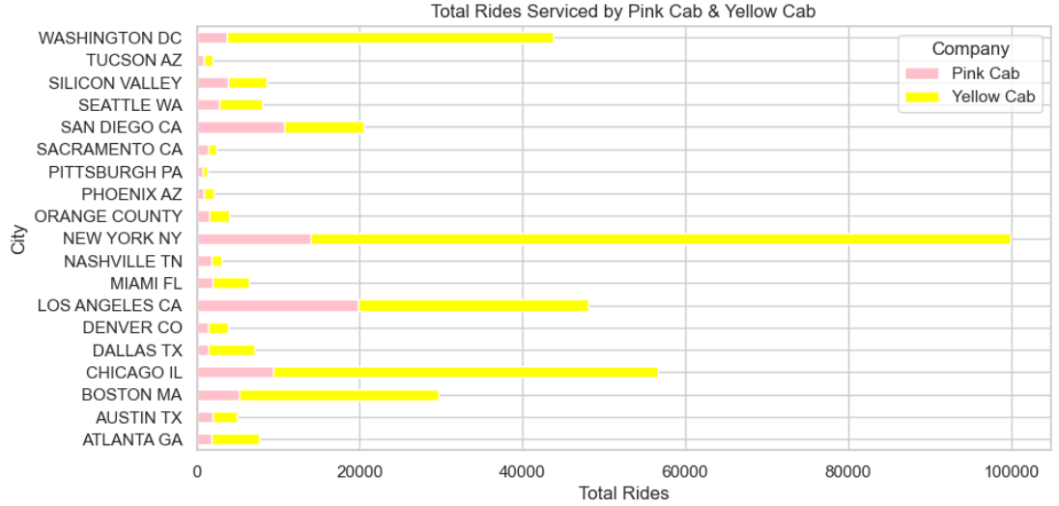
Ride Analysis City Totals
Top Yellow Cab Cities
New York, NY
Chicago, IL
Los Angeles, CA
Washington DC
Boston, MA
Top Pink Cab Cities
Los Angeles, CA
New York, NY
San Diego, CA
Chicago, IL
Boston, MA
Exploratory Data Analysis (EDA)

Slide 12
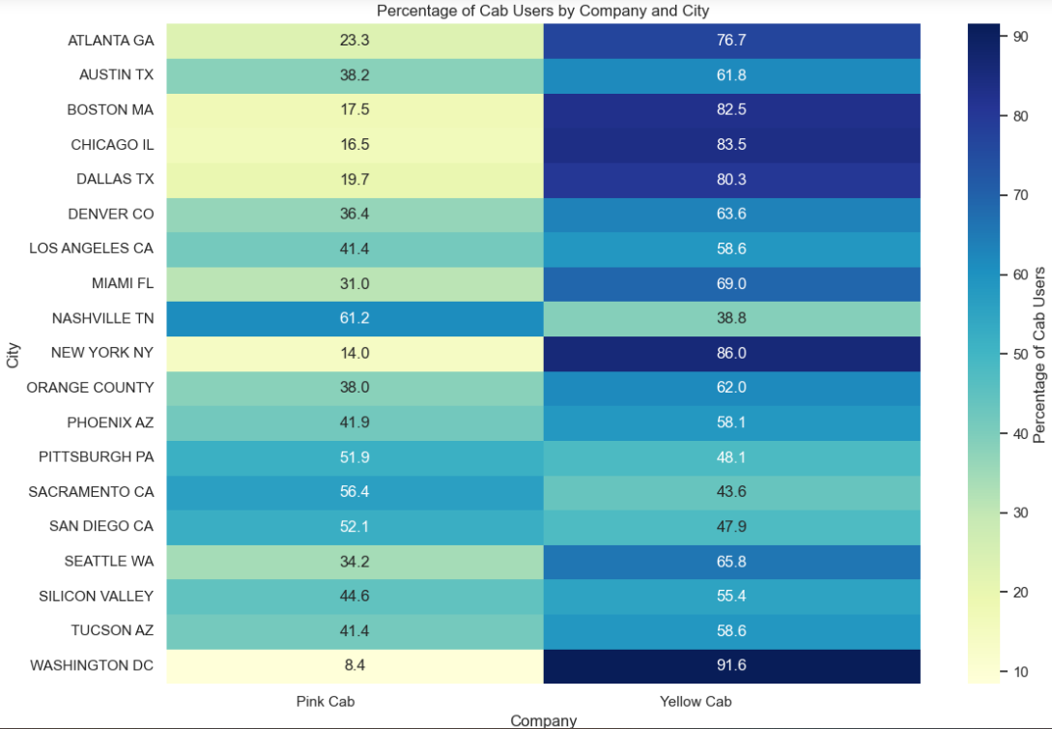
Ride Analysis
Yellow Cab Majority Cities
Washington DC
New York, NY
Chicago, IL
Boston, MA
Dallas, TX
Atlanta, GA
Miami, FL
Seattle, WA
Denver, CO
Orange County
Austin, TX
Tucson, AZ
Los Angeles, CA
Phoenix, AZ
Silicon Valley
Pink Cab Majority Cities
Nashville, TN
Sacramento, CA
San Diego, CA
Pittsburgh, PA
Exploratory Data Analysis (EDA)

Slide 13
Customer Analysis
Total Customers by Company
Distribution of Age by Gender
Distribution of Monthly Income by Age Group
Percentage of Multiple-Ride Customers
Exploratory Data Analysis (EDA)

Slide 14
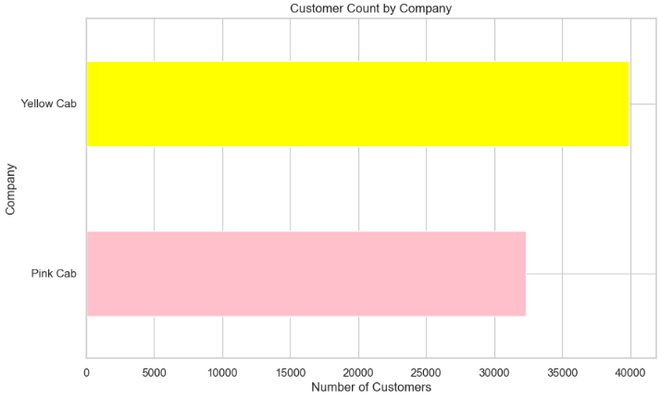
Customer Analysis Total
Noteworthy Points
Yellow Cab has about 23.4% more customers than Pink Cab.
According to previously included data*, Yellow Cab also consistently services more than 76% of total rides per year.
* Percentage by Year
39,896
32,330
Exploratory Data Analysis (EDA)

Slide 15
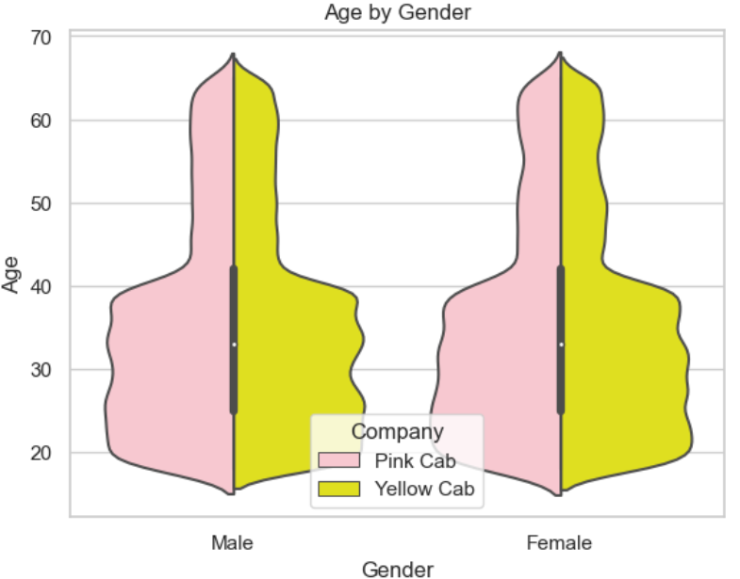
Customer Analysis Age-Gender
Interpretation
Both Yellow Cab and Pink Cab have very similar demographics in their customers when looking at age and gender.
The mean age of customer for both companies is 35.
Exploratory Data Analysis (EDA)

Slide 16
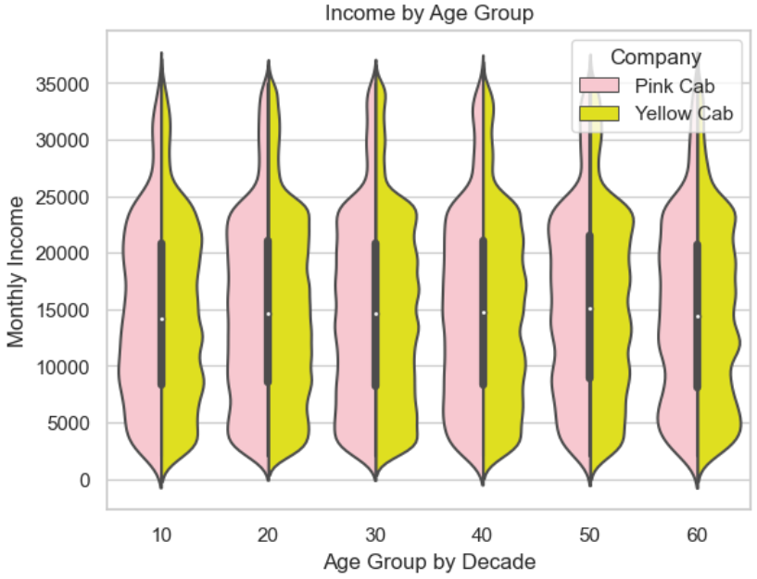
Customer Analysis Age-Income
Interpretation
Both Yellow Cab and Pink Cab have very similar distribution of wealth across their customer base.
The highest earning group is 50-year-olds with a monthly average of 15,400-15,600 USD.
The lowest earning group is teenagers with a monthly average of 14,700-14,800 USD.
Exploratory Data Analysis (EDA)

Slide 17
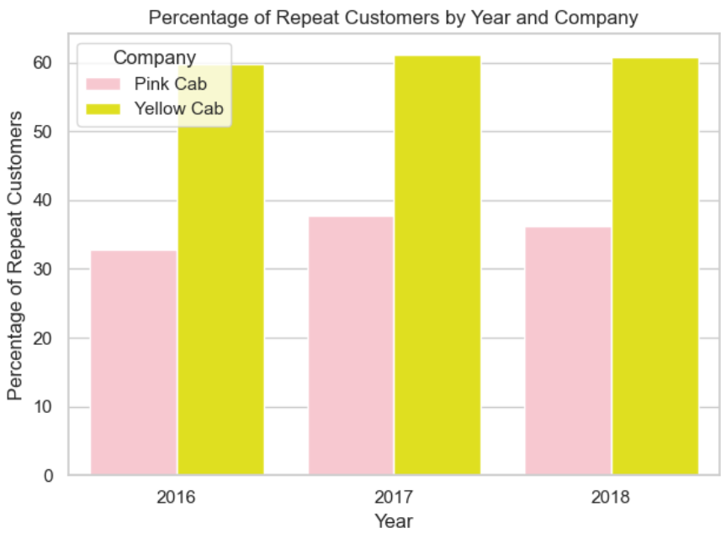
Customer Analysis Multiple Rides
Trends
Yellow Cab had multiple transactions from roughly 60% of their customers per year.
Pink Cab had multiple transactions from less than 40% of their customers per year.
Exploratory Data Analysis (EDA)

Slide 18
Profit Analysis
Total by Year
Average Cost per Ride
Average Profit per Ride
All figures in USD
Exploratory Data Analysis (EDA)

Slide 19
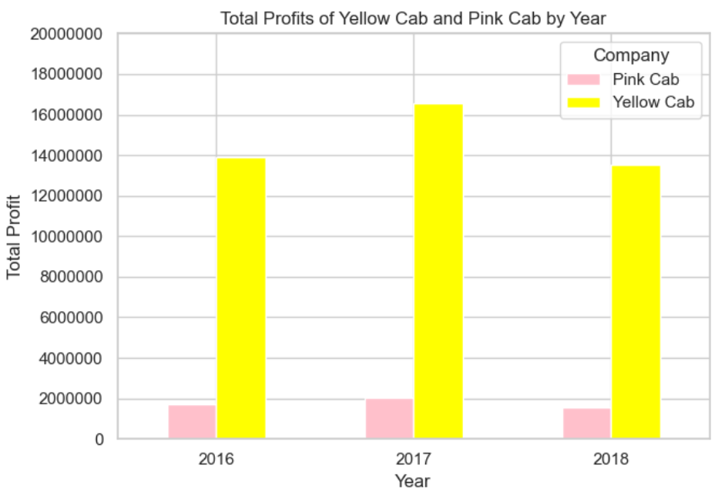
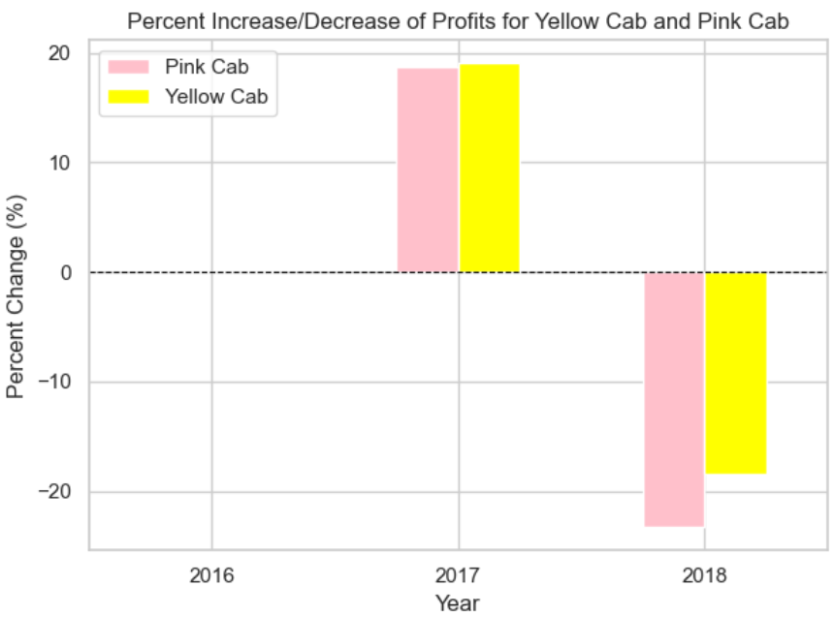
Profit Analysis
Total by Year
Percent Change
16,575,980
13,927,000
13,517,400
No bars for 2016 because that is where the data starts.
18.7%
19.02%
-18.5%
-23.3%
1,713,511
2,033,655
1,560,162
Exploratory Data Analysis (EDA)

Slide 20
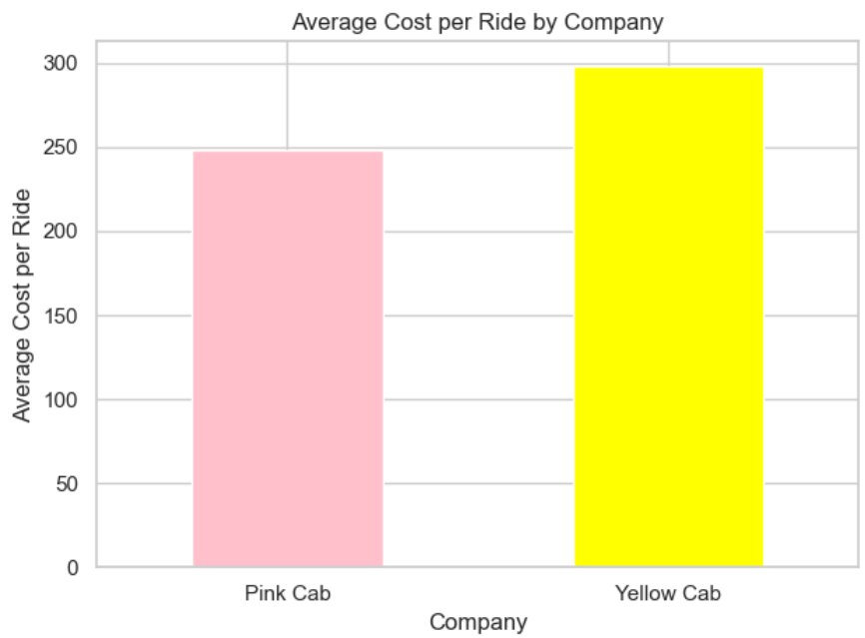
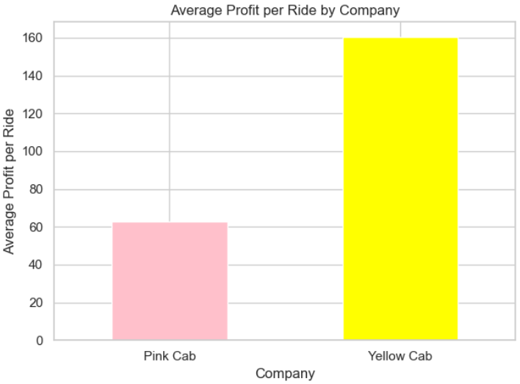
Profit Analysis Average per Ride
297.92
160.26
248.15
62.65
Exploratory Data Analysis (EDA)

Slide 21
EDA Summary
Rides
Yellow Cab serviced the most rides in all categories
Cities
Yellow Cab dominated the market in over 70% of cities
Customers
Yellow Cab had roughly 7.5k more customers, 23% more than Pink Cab.
Yellow Cab serviced about 76% more rides per year than Pink Cab.
Age, gender, and monthly income distributions are comparable for both companies.
About 60% of Yellow Cab customers have multiple rides each year, whereas less than 40% of Pink Cab customers have multiple rides a year.
Profit
Yellow Cab had more total profits by far per year.
Yellow Cab’s average cost per ride is about $50 more than Pink Cab’s.
Yellow Cab’s average profit per ride is about $100 more than Pink Cab’s.
Pink Cab’s profits decreased by 23.3% in 2018, whereas Yellow Cab’s profits decreased by 18.5%.

Slide 22
Recommendation
Yellow Cab

Slide 23
Thank You

